Slide 1
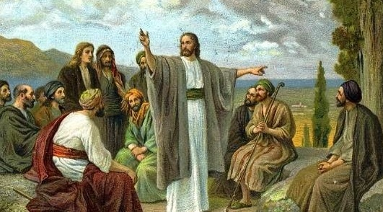
Kilcornan Parish

Slide 2
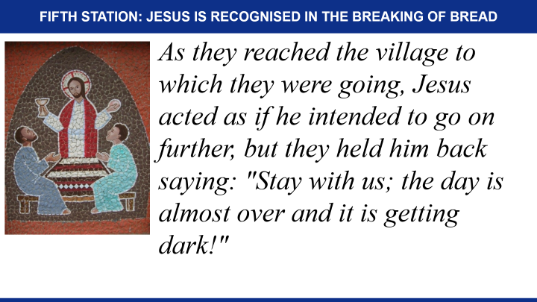
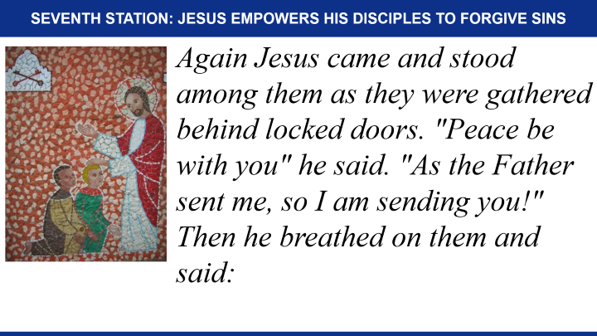
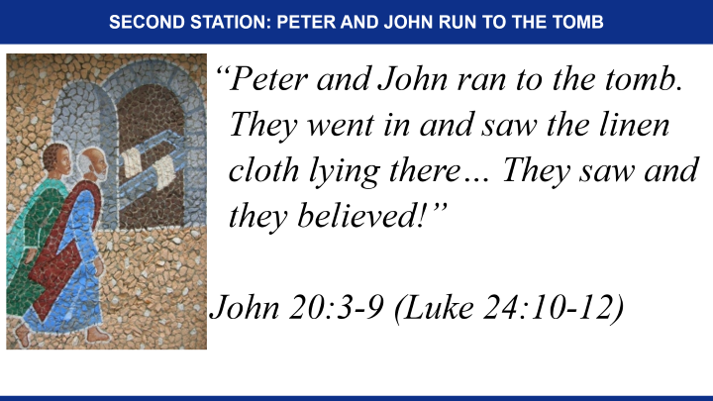
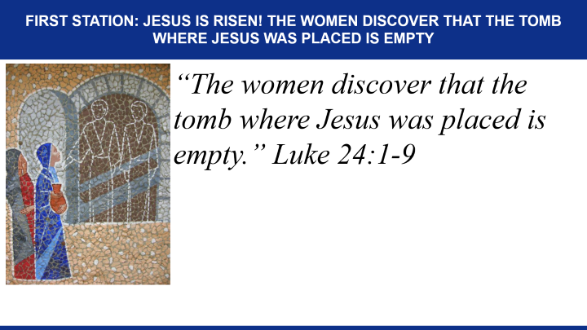
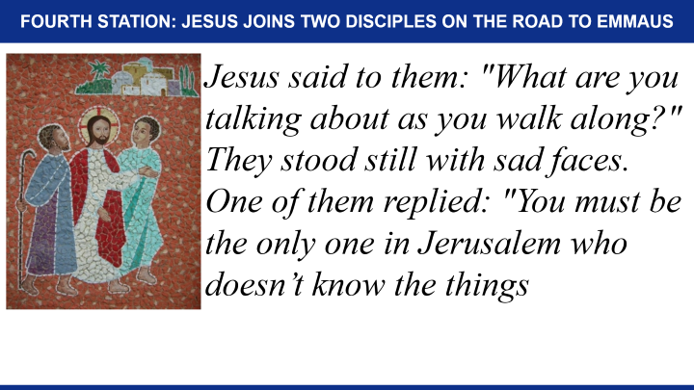
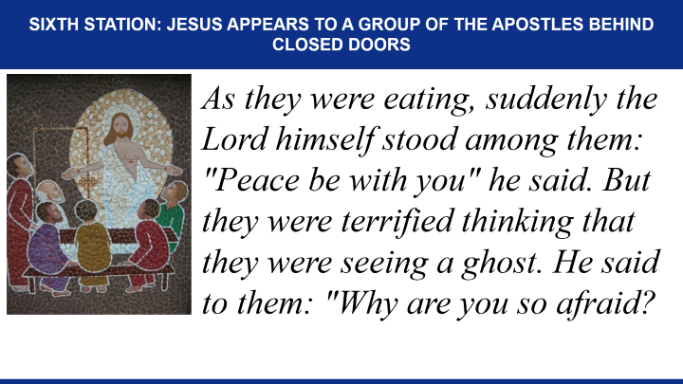
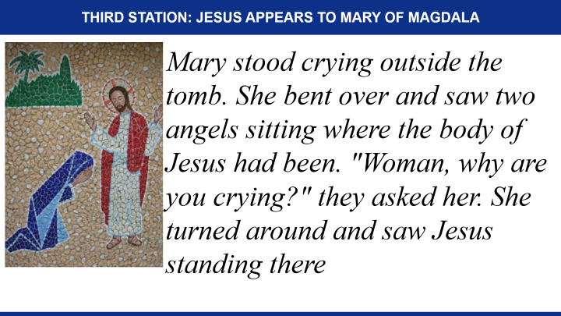
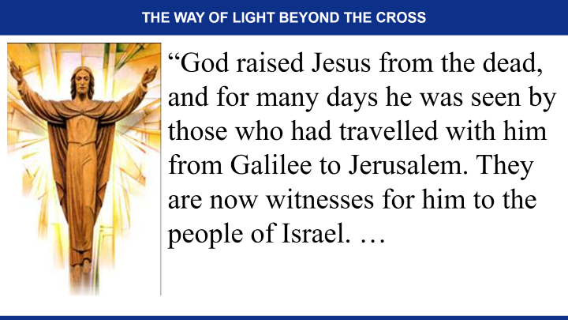
The Way of Light beyond the Cross

Slide 3
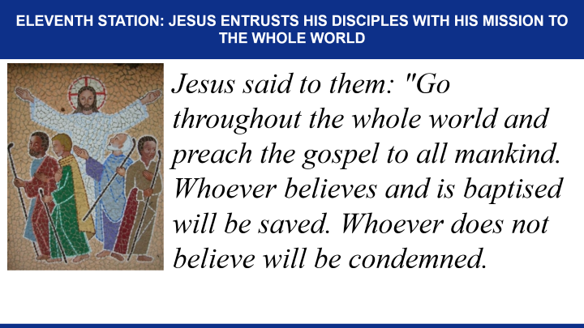
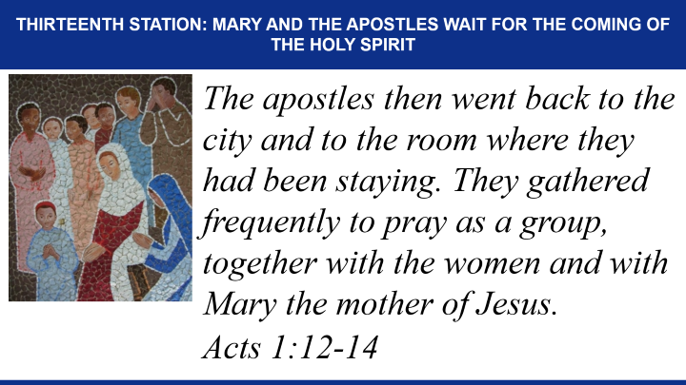
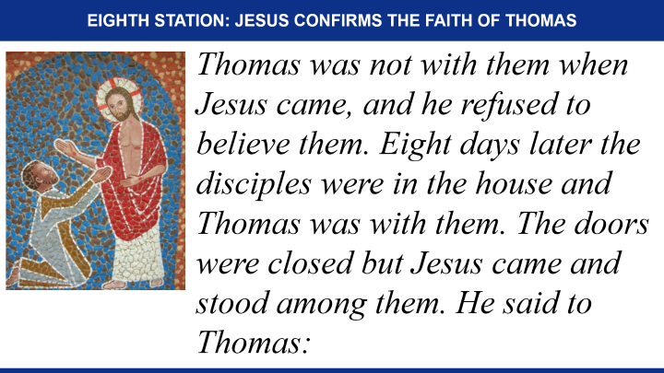
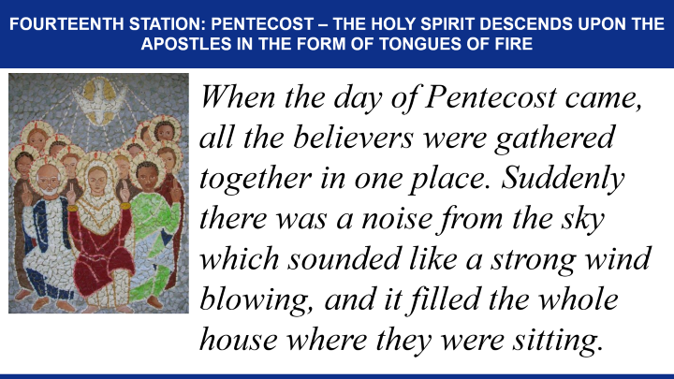
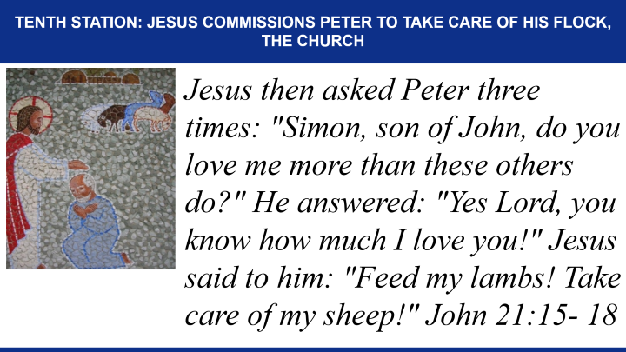
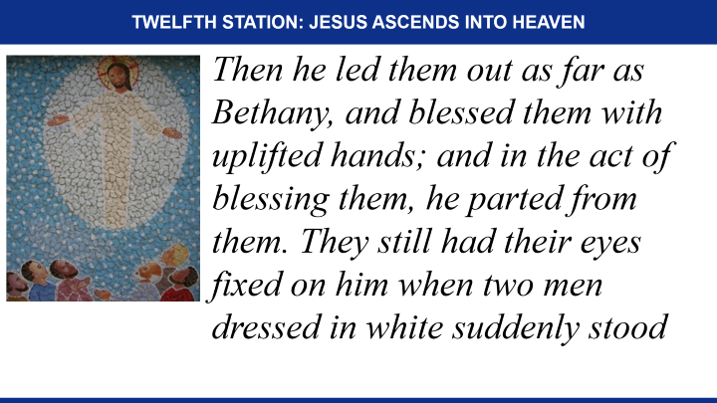
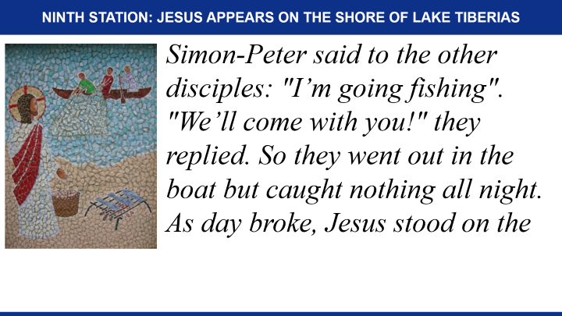
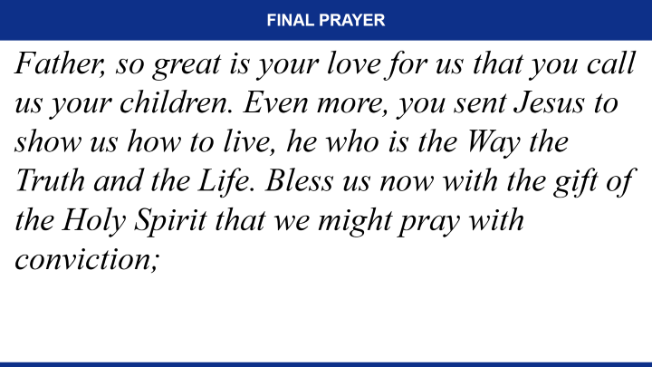
The Way of Light beyond the Cross

Slide 4
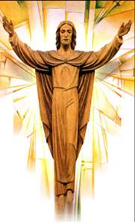
The Way of Light beyond the Cross
“God raised Jesus from the dead, and for many days he was seen by those who had travelled with him from Galilee to Jerusalem. They are now witnesses for him to the people of Israel. …

Slide 5
The Way of Light beyond the Cross
… And we are here to bring the Good News to you! What God promised our ancestors he would do, he has now done for us, who are their descendants, by raising Jesus to life” Acts 13: 30-33

Slide 6
First Station: Jesus is Risen! The women discover that the tomb where Jesus was placed is empty
“The women discover that the tomb where Jesus was placed is empty.” Luke 24:1-9

Slide 7
Let us pray
Risen Lord, your resurrection is truly good news!
We praise you for your victory over sin and death!

Slide 8
Let us pray
Your resurrection brings us hope, salvation and the beginning of a new life in you!
Help us to keep growing in the conviction that at the end, our life is not ended, only changed!
Amen

Slide 9
Let us sing
Sing Alleluia to the Lord (x2)
Sing Alleluia sing Alleluia.
Sing Alleluia to the Lord!
Jesus is risen from the dead (x2)
Jesus is risen, Jesus is risen
Jesus is risen from the dead!

Slide 10
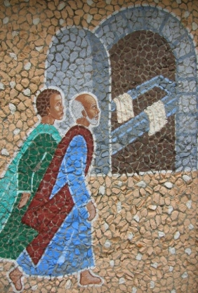
Second Station: Peter and John run to the tomb
“Peter and John ran to the tomb.
They went in and saw the linen
cloth lying there… They saw and
they believed!”
John 20:3-9 (Luke 24:10-12)

Slide 11
Let us pray
Risen Lord, as we stand before your empty tomb, you invite us to experience what Peter and John experienced.

Slide 12
Let us pray
As we reflect on the mystery of your death and resurrection, grant us the grace to understand more fully the blood by which we were redeemed and the Spirit by which we are reborn.
Amen.

Slide 13
Let us sing
This is the day! When he rose again!
Let us rejoice! And be glad in it.
This is the day that the Lord has made;
Let us rejoice and be glad in it
This is the day when he rose again!

Slide 14
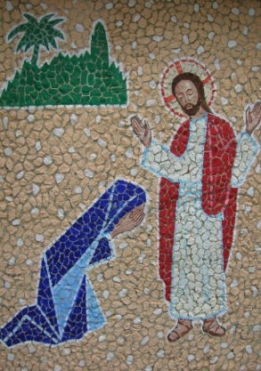
Third Station: Jesus appears to Mary of Magdala
Mary stood crying outside the tomb. She bent over and saw two angels sitting where the body of Jesus had been. "Woman, why are you crying?" they asked her. She turned around and saw Jesus standing there

Slide 15
Third Station: Jesus appears to Mary of Magdala
although she did not recognise him. Thinking he was the gardener she said: "Tell me where you have put him and I will go fetch him!" Jesus said to her: "Mary!" facing him she replied: "Rabboni", meaning "master!" John 20:11-18

Slide 16
Let us pray
Risen Lord, you provided Mary of Magdala the opportunity to be the first to witness your risen self, and you commissioned her to go spread the news.

Slide 17
Let us pray
As with Mary, you call us all by our name and you ask us to share this good news with all whom we meet. Help us to do so courageously.
Amen.

Slide 18
Let us sing
Alleluia Alleluia give thanks to the risen Lord;
Alleluia Alleluia give praise to his name!
Spread the good news over all the earth – Jesus has died and is risen!

Slide 19
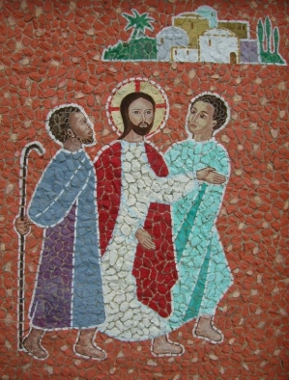
Fourth Station: Jesus joins two disciples on the road to Emmaus
Jesus said to them: "What are you talking about as you walk along?" They stood still with sad faces. One of them replied: "You must be the only one in Jerusalem who doesn’t know the things

Slide 20
Fourth Station: Jesus joins two disciples on the road to Emmaus
that have been happening there these last few days!" Then Jesus said: "How foolish you are; how slow you are to believe everything the prophets wrote."

Slide 21
Fourth Station: Jesus joins two disciples on the road to Emmaus
And he went on to explain what was said about himself in all the scriptures, beginning from the books of Moses to the writings of all the prophets. Luke 24:13-27

Slide 22
Let us pray
Risen Lord, you joined your two disciples as in their confusion they tried to walk away from it all. You helped them to understand the true meaning of the events that had made them so sad.

Slide 23
Let us pray
Their invitation: "Stay with us" has become our prayer. Help us to keep recognising you in the ones who walk beside us in our times of trouble.
Amen.

Slide 24
Let us sing
Jesus promised life to all
Walk, walk in the Light!
The dead were wakened by his call!
Walk, walk in the Light!

Slide 25
Let us sing
Walk in the Light (x3),
Walk in the Light of God!
He died in pain on Calvary, Walk...
To save the lost like you and me, Walk...

Slide 26
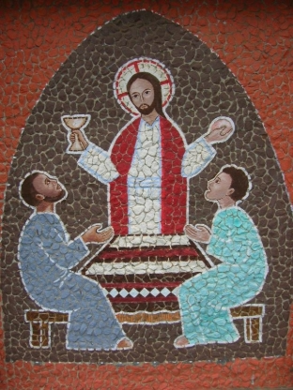
Fifth Station: Jesus is recognised in the breaking of bread
As they reached the village to which they were going, Jesus acted as if he intended to go on further, but they held him back saying: "Stay with us; the day is almost over and it is getting dark!"

Slide 27
Fifth Station: Jesus is recognised in the breaking of bread
So he went in and sat down to eat with them. He took bread, said the blessing, broke it and gave it to them. At that moment their eyes were opened and they recognised him, but he vanished from their sight.

Slide 28
Fifth Station: Jesus is recognised in the breaking of bread
They said to each other then: "Wasn’t it like a fire burning in us when he talked to us on the road explaining the scriptures?" Luke 28-35

Slide 29
Let us pray
Risen Lord, as the two disciples recognised you in the breaking of bread, they recognised themselves also. They were still your disciples! Your words restored their faith in you.

Slide 30
Let us pray
Every time we celebrate the Eucharist, you invite us to be restored again as your followers, as we listen to your Word and share in your Body and Blood.
Amen.

Slide 31
Let us sing
Are not our hearts burning within us?
Are not our hearts lighted with fire?
Jesus is with us is risen is with us;
Jesus is risen is with us today!
Jesus is the Lord! Jesus is the Lord!

Slide 32
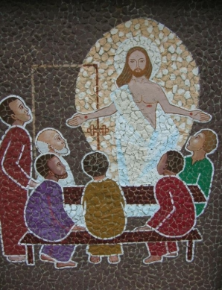
Sixth Station: Jesus appears to a group of the apostles behind closed doors
As they were eating, suddenly the Lord himself stood among them: "Peace be with you" he said. But they were terrified thinking that they were seeing a ghost. He said to them: "Why are you so afraid?

Slide 33
Sixth Station: Jesus appears to a group of the apostles behind closed doors
Why all these doubts in your minds? Look at my hands and my feet, and see that it is I. A ghost does not have flesh and bones as you can see I have! They still could not believe, even though

Slide 34
Sixth Station: Jesus appears to a group of the apostles behind closed doors
they were filled with joy and wonder. He asked them: "Have you anything to eat? They gave him a piece of cooked fish, which he took and ate in their presence. Luke 24:36-43

Slide 35
Let us pray
Risen Lord, we still find it hard to believe in your resurrection and ours. We have no proof! But help us to notice the signs you provide us with in nature around us;

Slide 36
Let us pray
that as the seed sprouts into life, and as sure as the sun rises again every morning, so certain can we be that death is not only a tombstone but a stepping stone into eternal life!
Amen.

Slide 37
Let us sing
Keep in mind that Jesus Christ has died for us
and is risen from the dead!
You are our risen Lord; you are joy for all ages!

Slide 38
Let us sing
In you Lord our challenge, in you all our hope!
In you our salvation, in you all our love.

Slide 39
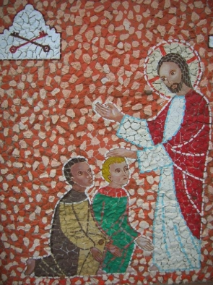
Seventh Station: Jesus empowers his disciples to forgive sins
Again Jesus came and stood among them as they were gathered behind locked doors. "Peace be with you" he said. "As the Father sent me, so I am sending you!" Then he breathed on them and said:

Slide 40
Seventh Station: Jesus empowers his disciples to forgive sins
"Receive the Holy Spirit. Those whose sins you forgive, will be forgiven. Those whose sins you retain, they are retained!" John 20:21-23

Slide 41
Let us pray
Risen Lord, you appeared to the apostles and breathed the Holy Spirit upon them; pour out on us your healing Spirit, that we may continue your mission of bringing forgiveness to our wounded world.
Amen.

Slide 42
Let us sing
God forgave my sins in Jesus’ name,
I’ve been born again in Jesus’ name;
And in Jesus’ name I come to you,
To share his love as he told me to!

Slide 43
Let us sing
He said: "Freely Freely you have received;
Freely Freely give!
Go in my name and because you believe,
Others will know that I live!"

Slide 44
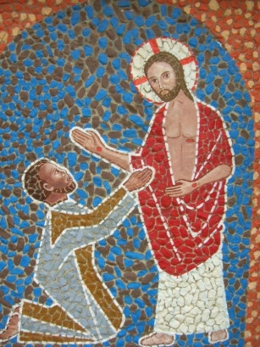
Eighth Station: Jesus confirms the faith of Thomas
Thomas was not with them when Jesus came, and he refused to believe them. Eight days later the disciples were in the house and Thomas was with them. The doors were closed but Jesus came and stood among them. He said to Thomas:

Slide 45
Eighth Station: Jesus confirms the faith of Thomas
"Reach out your hand and put it into my side. Look at my hands! Doubt no longer, but believe!" Thomas said: "My Lord and my God!" Jesus replied: "You believe because you can see me. Blessed are they who will believe without having seen me." John 20:24-29

Slide 46
Let us pray
Risen Lord, you renewed the faith of Thomas in you as the Risen one! His faith is the faith of the Church. Preserve the church you built on the apostles, deepen our faith in your final victory, and help us find strength in the hope of your coming again. Amen.

Slide 47
Let us sing
You are Lord, you are Lord,
You are risen from the dead and you are Lord!
Every knee shall bow and every tongue confess,
That Jesus you are Lord!

Slide 48
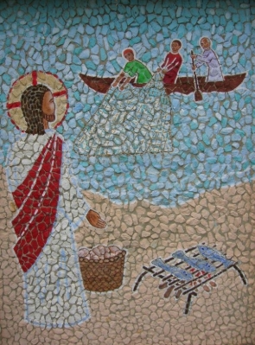
Ninth Station: Jesus appears on the shore of lake Tiberias
Simon-Peter said to the other disciples: "I’m going fishing". "We’ll come with you!" they replied. So they went out in the boat but caught nothing all night. As day broke, Jesus stood on the

Slide 49
Ninth Station: Jesus appears on the shore of lake Tiberias
shore, though the disciples did not realise it was Jesus. Jesus called out: Have you caught anything friends?" And when they answered "No!", he said to them: "Throw the net out to starboard and you’ll get

Slide 50
Ninth Station: Jesus appears on the shore of lake Tiberias
something." They did so and there were so many fish that they could not haul the net in. The disciple Jesus loved said: "It is the Lord!" John 21:1-19

Slide 51
Let us pray
Risen Lord, in the sign of so many fish gathered in the single unbroken net, you indicate your desire that all people of all nations be gathered into one holy people.

Slide 52
Let us pray
As you directed your disciples to that great catch of fish, continue to direct us in the way of unity. Amen.

Slide 53
Let us sing
Lord you have come to the lakeside;
Seeking neither wealthy nor wise ones.
You only ask Lord, that I should love you.

Slide 54
Let us sing
With love you have looked in my eyes Lord,
Smiling gently you called out my name.
And I left my boat by the lakeside,
Now with you I will seek other shores!

Slide 55
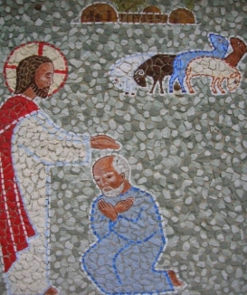
Tenth Station: Jesus commissions Peter to take care of his flock, the Church
Jesus then asked Peter three times: "Simon, son of John, do you love me more than these others do?" He answered: "Yes Lord, you know how much I love you!" Jesus said to him: "Feed my lambs! Take care of my sheep!" John 21:15- 18

Slide 56
Let us pray
Risen Lord, you not only forgave Peter for denying you three times, you appointed him to be the leader of your followers, the Shepherd of your flock. Having recommitted himself to love you to the end, he assumed the responsibility of leading your people

Slide 57
Let us pray
in discovering healing through your loving forgiveness. May the successor of Peter continue to preserve your church in the way of truth and life, and may we too be faithful in fulfilling our mission to spread the good news of salvation. Amen.

Slide 58
Let us sing
Colours of day dawn into the mind
The sun has come up the night is behind.
Go down in the city, into the street,
And let’s give the message to the people we meet.

Slide 59
Let us sing
So light up the fire and let the flame burn,
Open the door, let Jesus return.
Take seeds of his Spirit, let the fruit grow,
Tell the people of Jesus let his love show.

Slide 60
Let us sing
Go through the park on into the town
The sun still shines on, it never goes down.
The light of the world is risen again,
The people of darkness need the Good News!

Slide 61
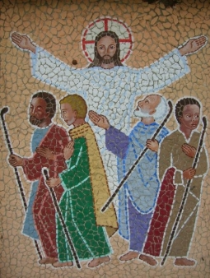
Eleventh Station: Jesus entrusts his disciples with his mission to the whole world
Jesus said to them: "Go throughout the whole world and preach the gospel to all mankind. Whoever believes and is baptised will be saved. Whoever does not believe will be condemned.

Slide 62
Eleventh Station: Jesus entrusts his disciples with his mission to the whole world
And believers will be given the power to perform miracles. They will drive out demons in my name; they will speak in strange tongues; if they pick up snakes or drink

Slide 63
Eleventh Station: Jesus entrusts his disciples with his mission to the whole world
poison, they will not be harmed; they will place their hands on the sick, and these will be healed!" Mark 16:15-18
(Matthew 28:16-20 / Acts 1:6-8 / Luke 24:46-47)

Slide 64
Let us pray
Risen Lord, you helped your disciples to understand the wonderful mystery of your death and resurrection. Then you entrusted them with the task of being messengers of hope and.

Slide 65
Let us pray
bearers of the good news of your victory over sin and death. As we strive to pursue their mission, help us to manifest your resurrection by our way of life. Amen.

Slide 66
Let us sing
God’s Spirit is in my heart,
He has called me and set me apart;
This is what I have to do; what I have to do.
He sent me to bring the good news to the poor;
Tell prisoners that they are

Slide 67
Let us sing
prisoners no more!
Tell blind people that they can see;
And set the downtrodden free!
And go tell everyone the news that the Kingdom of God has come.
And go tell everyone the news that God’s Kingdom has come.

Slide 68
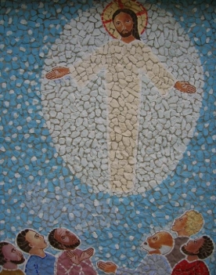
Twelfth Station: Jesus ascends into heaven
Then he led them out as far as Bethany, and blessed them with uplifted hands; and in the act of blessing them, he parted from them. They still had their eyes fixed on him when two men dressed in white suddenly stood

Slide 69
Twelfth Station: Jesus ascends into heaven
beside them and said: "Galileans, why are you standing there looking up at the sky? This Jesus who was taken from you into heaven will come back in the same way you saw him go to heaven!" Luke:24:50-52 / Acts 1:9-11

Slide 70
Let us pray
Risen Lord, your promise of the gift of the Holy Spirit and your promise to be with us always, fills us with joy. Where you, the head have preceded us in glory,

Slide 71
Let us pray
we, the body, hope to follow. Seated at the right hand of the Father, intercede for us now, as we place all our trust in you, our eternal priest. Amen.

Slide 72
Let us sing
Jesus, name above all names
Beautiful Saviour, glorious Lord.
Emmanuel, God is with us,
Blessed Redeemer, living Word!

Slide 73
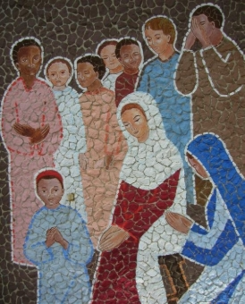
Thirteenth Station: Mary and the apostles wait for the coming of the Holy Spirit
The apostles then went back to the city and to the room where they had been staying. They gathered frequently to pray as a group, together with the women and with Mary the mother of Jesus.
Acts 1:12-14

Slide 74
Let us pray
Risen Lord, this little group of your followers waiting and praying together in the Upper Room was the church in embryonic form. Gathered still with the whole communion of saints,

Slide 75
Let us pray
we pray that you will again pour out the gifts of the Holy Spirit on all people and so fulfil in the hearts of your faithful what you accomplished when the Gospel was first preached on earth.
Amen.

Slide 76
Let us sing
Spirit of the living God, fall afresh on us (x2)
Melt us, mould us, fill us, use us!
Spirit of the living God, fall afresh on us!

Slide 77
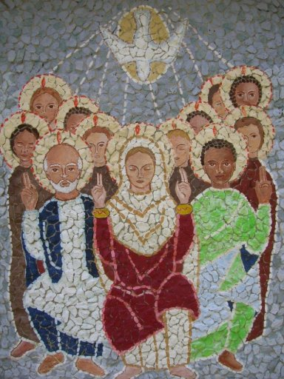
Fourteenth Station: Pentecost – The Holy Spirit descends upon the apostles in the form of tongues of fire
When the day of Pentecost came, all the believers were gathered together in one place. Suddenly there was a noise from the sky which sounded like a strong wind blowing, and it filled the whole house where they were sitting.

Slide 78
Fourteenth Station: Pentecost – The Holy Spirit descends upon the apostles in the form of tongues of fire
Then they saw what looked like tongues of fire which spread out and touched each person there. They were all filled with the Holy Spirit and began to talk in other languages as the Spirit enabled them to speak!" Acts 2:1-42

Slide 79
Let us pray
God our Father, we thank you for sending us your only Son to call us into your Kingdom. Set us on fire like his first disciples, with the power of the Holy Spirit. Help us to act justly, to love tenderly,

Slide 80
Let us pray
and to walk humbly with you. Help us to become a community serving humanity in your great plan to renew the face of the earth. We ask this through Christ our Lord. Amen

Slide 81
Let us sing
Sing Alleluia to the Lord
Sing Alleluia to the Lord
Sing Alleluia, sing Alleluia,
Sing Alleluia to the Lord!

Slide 82
Let us sing
Come Holy Spirit fill our hearts. Come Holy Spirit fill our hearts.
And kindle in them the fire of your love.
Come Holy Spirit fill our hearts!

Slide 83
Final Prayer
Father, so great is your love for us that you call us your children. Even more, you sent Jesus to show us how to live, he who is the Way the Truth and the Life. Bless us now with the gift of the Holy Spirit that we might pray with conviction;

Slide 84
Final Prayer
"Come Lord Jesus!" Help us to know him better and to share our experience of him with others as we prepare for and cross the threshold into the third millennium. We make our prayer through Christ our Lord.
Amen

